Slide 1
Physical Parameters of Compost
Wayne H. Thompson
Texas Cooperative Extension - Houston, TX and

Slide 2

Electrical Conductivity
Relative Impact of Ions
Wayne H. Thompson
Texas Cooperative Extension
Houston, TX 77084

Slide 3
Overview
Why Model Compost EC?
Background on EC
Data : Methods
Model
  Development and Evaluation
  A Few Examples
Conclusions

Slide 4
Issues in Sample Testing
sample heterogeneity
  variations in physical, biological and chemical characteristics across and within sub-samples
    typically high following inadequate compost pile mixing
sample variability is often stratified across sieve size fractions

Slide 5
Why Develop a Model?
Compost EC is often misinterpreted
  frequently used as a limiting indicator of compost quality
  elements causing conductance not used as part of the diagnostics process
  different feedstock combinations
    compost ECs vary from 0.1 to over 20 dS m⁻¹
To illustrate components of EC
  tool for end-use interpretation
  tool for process control

Slide 6
Background on EC … Other Uses
Estimate aliquot size for chemical analysis
Check reliability of chemical analysis
Evaluate and express corrosion likelihood
Assess purity of demineralized water
Estimates and Approximations
  total ion concentration mmoles charge L⁻¹ ≈ 10 × EC, in dS m⁻¹
  osmotic pressure kPa at 25°C ≈ 0.36 × EC, in dS m⁻¹
  total dissolved solids mg L⁻¹ ≈ 640 × EC, in dS m⁻¹
Adapted from J.D. Rhodes. Salinity: EC and Total Dissolved Solids In Methods of Soil Analysis, Ch 14

Slide 7
Background to EC Measurement
EC Methods adapted from soil methods
  Saturation extract and extracts of soil:water ratios
    1:1, 1:2_{v/v}, 1:5_{dw/w}
Considerations for Compost (like Organic Soils)
  determined on moist samples, not air-dried as with mineral soils
  small amounts of free water lead to “appreciable errors” in saturation paste water contents
Adapted from J.D. Rhodes. Salinity: EC and Total Dissolved Solids In Methods of Soil Analysis, Ch 14

Slide 8
Data … Laboratory Methods
Laboratory Sample Preparation
  Water Soluble
    1:5_{w/w} extract – Blend 20g as received moist sample on dw basis with equivalent of 100 mL DI- distilled H₂O shaken with wrist action for 15 min, and centrifuged at 3200 rpm for 10 min, filtered with (??) 0.45 micron filter
    For Cl, NH₄-N + NO₃-N, SO₄, pH, EC
  Totals
    Air-dried, milled aliquot (Wiley)
    For TN, P, K, Na, Ca, Mg
1:5_{w/w} Determinations
  Ion Chromatograph
    Cl⁻, SO₄, NH₄-N
  Colorimetric
    NO₂-N + NO₃-N, NH₄-N + NH₃-N
  Electrometric pH
    2-point meter calibration
  Electrical Conductivity
    2-point meter calibration
Open Vessel Digest with ICP-AES Determination
  5 mL HNO₃, 10 min, 10 mL 50% HNO₃ + 3 mL 50% HCl, heat 95°C for 4h
  Parameters: P, K, Ca, Mg, and Na
Dry Combustion
  Total nitrogen
  ON calculated by subtracting nitrate- and ammonium-nitrogen from TN

Slide 9
Data … Laboratory Methods
Laboratory Sample Preparation
  Water Soluble
    1:5_{w/w} extract – Blend 20g as received moist sample on dw basis with equivalent of 100 mL DI- distilled H₂O shaken with wrist action for 15 min, and centrifuged at 3200 rpm for 10 min, filtered with (??) 0.45 micron filter
    For Cl, NH₄-N + NO₃-N, SO₄, pH, EC
  Totals
    Air-dried, milled aliquot (Wiley)
    For TN, P, K, Na, Ca, Mg
1:5_{w/w} Determinations
  Ion Chromatograph
    Cl⁻, SO₄, NH₄-N
  Colorimetric
    NO₂-N + NO₃-N, NH₄-N + NH₃-N
  Electrometric pH
    2-point meter calibration
  Electrical Conductivity
    2-point meter calibration

Slide 10
Data … Laboratory Methods
Open Vessel Digest with ICP-AES Determination
  5 mL HNO₃, 10 min, 10 mL 50% HNO₃ + 3 mL 50% HCl, heat 95°C for 4h
  Parameters: P, K, Ca, Mg, and Na
Dry Combustion
  Total nitrogen
  ON calculated by subtracting nitrate- and ammonium-nitrogen from TN

Slide 11
Data … Summary Statistics

Slide 12
More Data … Summary Statistics

Slide 13
Correlation Matrix ...

Slide 14
Model Development
EC_{est} = β₀ + β₁x₁ + β₂x₂ + β₃x₃ + β₄x₄ + β₅x₅ + β₆x₆ + β₇x₇
coefficients: x 10⁻⁴
n = 1,588

Slide 15
Ions and Electrical Conductivity
Sodium
5±2%
Nitrate-N
8±1%
Sulfates
29±2%
Potassium
13±1%
Chloride
26±2%
Ammonium-N
16±1%

Slide 16
Cross Plot ... Measured vs Modeled
Two Data Sets: model n=1588, validation n=413
EC’ = 0.79 x EC_{1:5} + 1.1
(R² = 0.82)
n = 413

Slide 17
A Few Examples where EC > 10 dS m⁻¹
Cl^{-,} contribution to measured conductivity (ds m⁻¹)
Na
SO₄
NH₄-N
K
P
N
Other

Slide 18
A Few Examples where 5 < EC < 10 dS m⁻¹

Slide 19
Conclusions
EC alone can be an effective field test
EC is not a sole indicator of compost quality
  Additional parameters should be measured, e.g., as with this model …
    ON, P, K, Na, Cl, NH₄-N, and SO₄
Simplifies data interpretation for end-use and process control
Graphical diagnostic tool for
  Regulatory Community
  Compost Certification Programs
  Composting Community

Slide 20
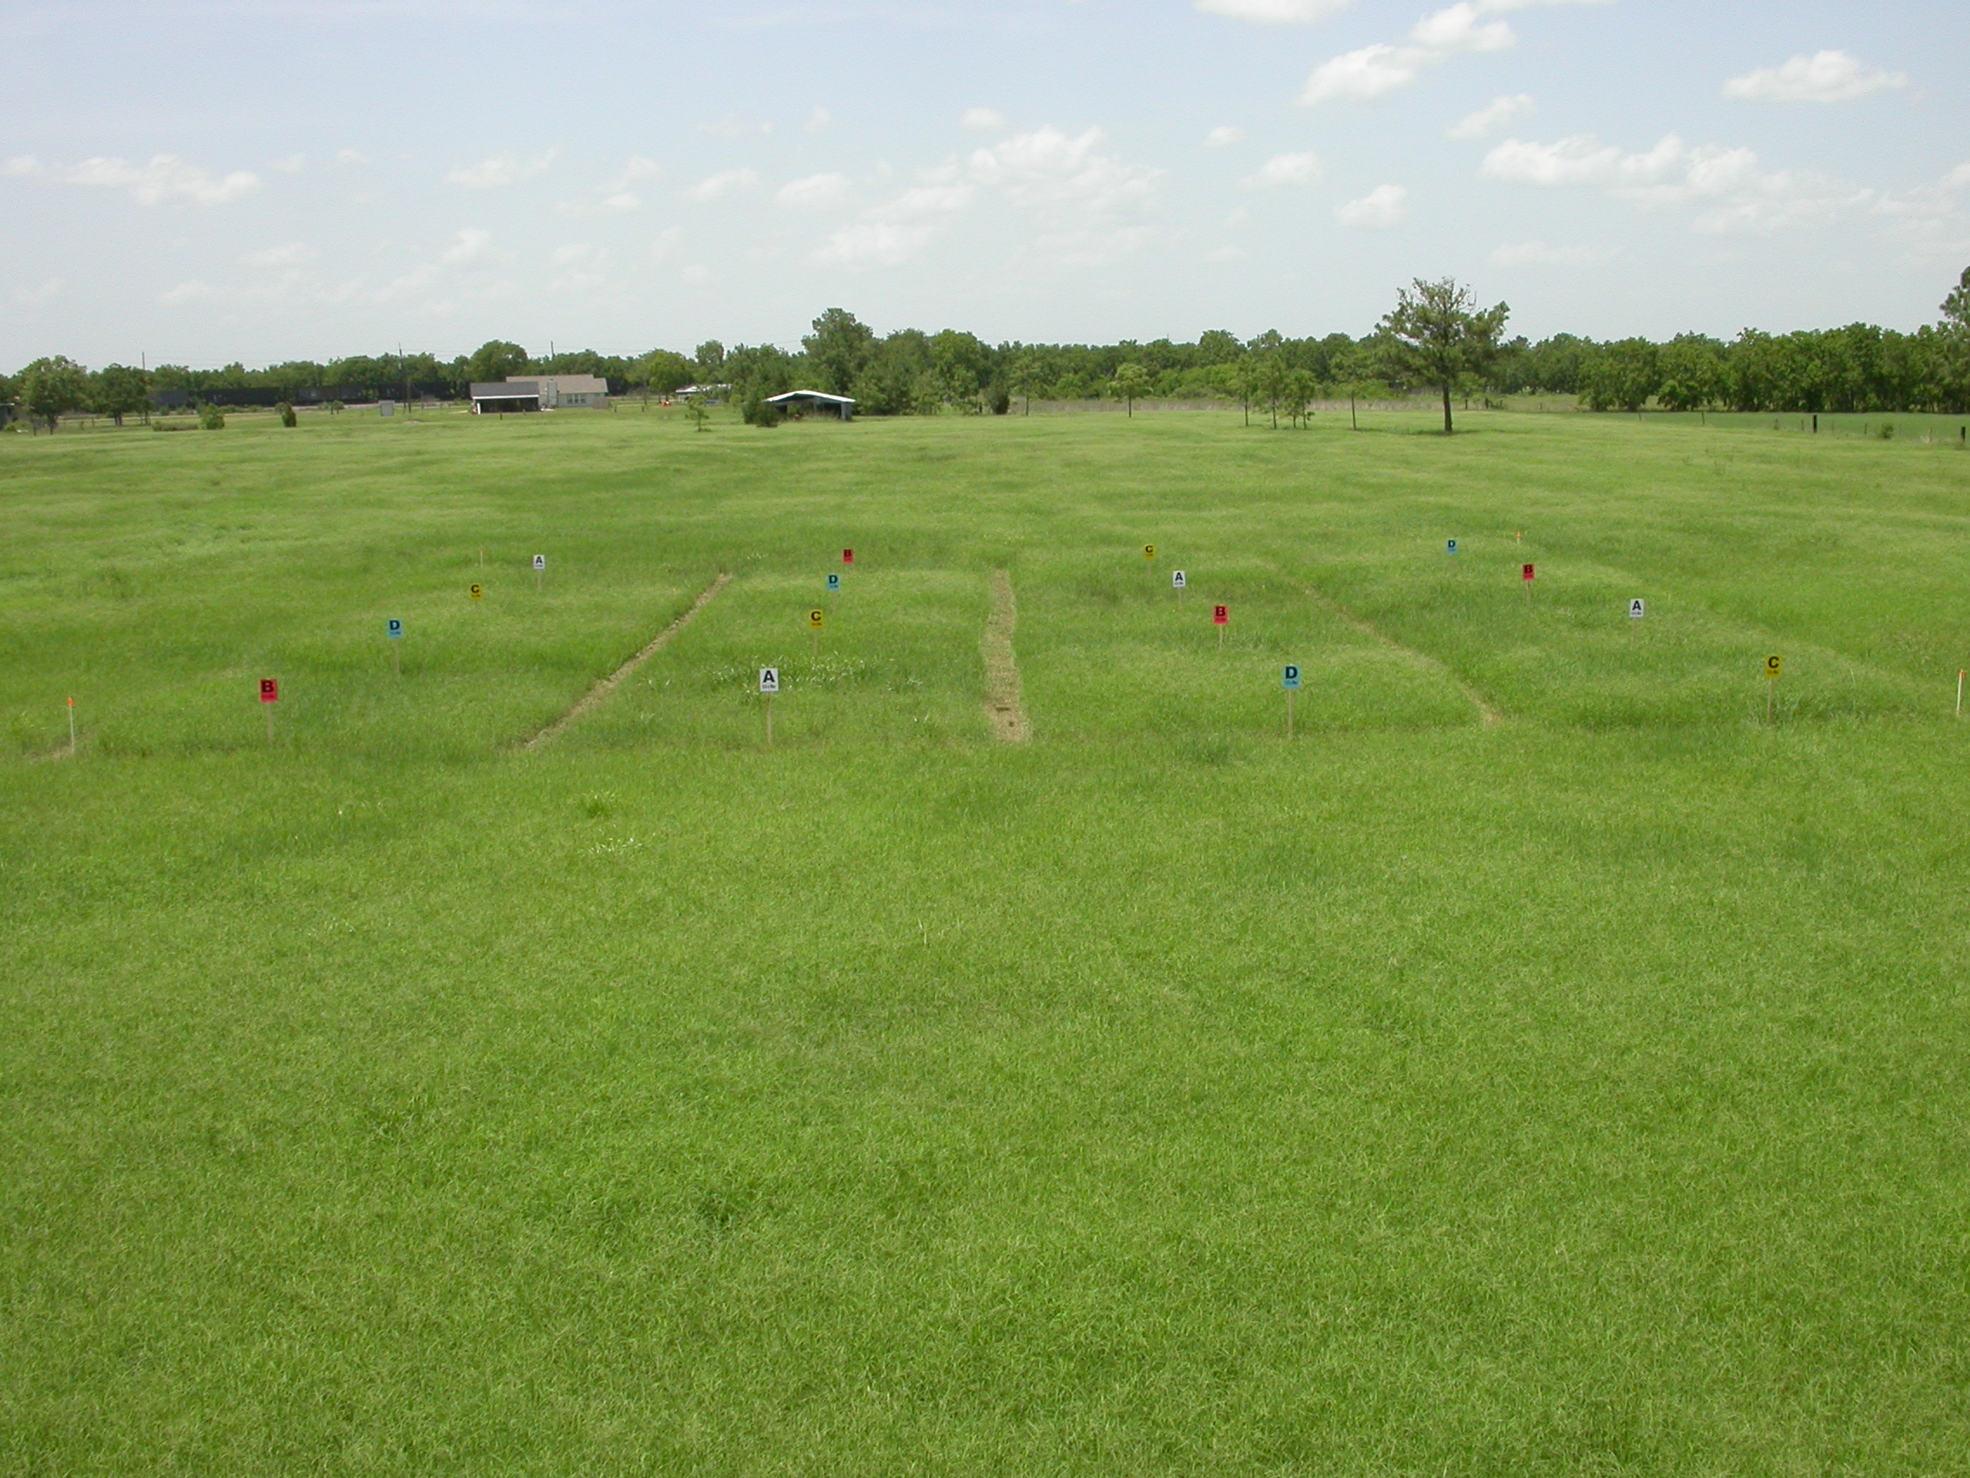
Thank you
Wayne H. Thompson
281-855-5612 office
281-960-9453 mobile
whthompson@ag.tamu.edu

Slide 21
Overview
Physical Parameters of Compost
  Feedstock Preparation and Product Finishing
  Typical Size Fractions
  Total Solids, Moisture and Wettability
  Bulk Density and Ash Content
  Inert Content
  Testing and Reporting

Slide 23
Correlation Matrix ...

Slide 24
EC due to Major Ions
Sodium
5±2%
Nitrate-N
8±1%
Sulfates
29±2%
Potassium
13±1%
Chloride
26±2%
Ammonium-N
16±1%

Slide 25
Bulk Density
mass of compost per unit volume of compost reported on a dry weight basis
  determined on a unit volume of a systematically compacted sample at as-received moisture
    estimate transportation requirements of bulk materials
    conversion from application rates on a mass per unit area basis to volume
bulk density increases through conversion of organic carbon to carbon dioxide and water
  Finished, well humified compost has higher bulk density than original feedstock blend

Slide 26
Bulk Density Correlates with Ash Content
The relationship between mineral content and bulk density is illustrated.
As ash content (inorganic matter) increases, one will typically observe a corresponding increase in sample density.

Slide 27
Film Plastics, Glass Shards, Metal Fragments and Hard Plastics
film plastics
  varied impacts under different compost use scenarios (aesthetic and/or ecological)
glass shards
  can pose a human and animal hazard with unprotected exposure or through direct ingestion
metal fragments
  can pose the same hazard, and could be a potential source of trace elements upon interaction with soil
hard plastic
  can be an aesthetic concern and in large quantities may affect physical properties of a compost-amended soil,
  (e.g., soil coloring, heat retention, drainage, etc.)

Slide 28
Sample Moisture and Testing
as-received moisture
  sieve size classification, total N on samples of biologically unstable compost, NH₄⁺, NO₃, pH, electrical conductivity, respirometry, pathogen testing, germination and growth, bulk density, water holding capacity (WHC), porosity/pore space, volatile fatty acids (VFA), and total solids and moisture.
air-dried at 36°C
  inert count, and after milling include heavy metals, plant nutrients (including total N for mature material low in ammonia), and organic carbon (OC).
oven dried at 70±5°C
  volatile solids and ash content on samples containing inerts, and ash and Loss-On-Ignition (LOI) organic matter content on inert-free, air-dried samples.

Slide 29
Systematic Errors, etc.
over-sized materials such as wood fragments and plastics cause over estimation of LOI OM
man-made inerts cause over estimation of ash content
sample is oven dried at 70±5°C rather than 103-105°C to minimize volatile loss of carbon compounds during determinations of total solids
  significance of this error increases with increasingly unstable and immature materials
negative errors on samples that require prolonged drying at relatively high temperatures
  error may become significant with feedstock where the organic fraction is very high relative to total solids
inaccurate reporting
  example: the formula OC = 0.5 x OM is inappropriately used to estimate organic carbon from LOI organic matter

Slide 30
Improper Use of Data for Reporting Purposes
Note statistically weak relationship
(R² of 0.62, n=685) between LOI OM and total carbon content.

Slide 31
Reporting Basis
Wet basis reporting increases potential for over application of nutrients
  specifically problematic for cropping systems in environmentally sensitive regions where nutrient utilization plans must be observed
Dry weight basis reporting
  required by EPA Chapter 40, CFR Part 503, etc.

Slide 32
Summary
heterogeneity of finished product
  accuracy of sample collection, process problem
  accuracy of test results/reported data
reporting analytical results
  parameter measures versus estimates
  dry versus as-received moist basis
applying analytical results
  distribution and shipping
  applications on agricultural lands and urban soils

